Slide 1
Student Data Analysis using Excel
KEERTHIKA R
STUDENT NAME:
REGISTER NO:
DEPARTMENT:
COLLEGE
313312009204.
312209204
B. Com BANK MANAGEMENT
:
ANNA ADARSH COLLEGE FOR WOMEN

Slide 2
PROJECT TITLE
Student Data Analysis using Excel

Slide 3


AGENDA
Problem Statement
Project Overview
End Users
Our Solution and Proposition
Dataset Description
Modelling Approach
Results and Discussion
Conclusion
3/21/2024 Annual Review

Slide 4

PROBLEM STATEMENT
To verify the students performance.

Slide 5

PROJECT OVERVIEW
To analyse overall performance of the student's and
increase efficiency of the students.
.

Slide 6

WHO ARE THE END USERS?
Principals
Teachers
Students

Slide 7

OUR SOLUTION AND ITS VALUE PROPOSITION
To identify the efficiency of the
students.

Slide 8
Dataset Description
Pivot table
Chart diagram

Slide 9

THE "WOW" IN OUR SOLUTION
To verify the students performance.
3/21/2024 Annual Review
‹#›

Slide 10
MODELLING
Firstly, open Ms Excel.
Then, Type the data that you are going to prepare an
analysis for students performance.
Select all and click insert menu.
Click Pivot Table and create the pivot table for the
particular student performance.
Then, click the any of bar or chart diagrams that you
going to prepare for the analysis.
Click ok and Save the file as “STUDENT DATA ANALYSIS”.
‹#›

Slide 11
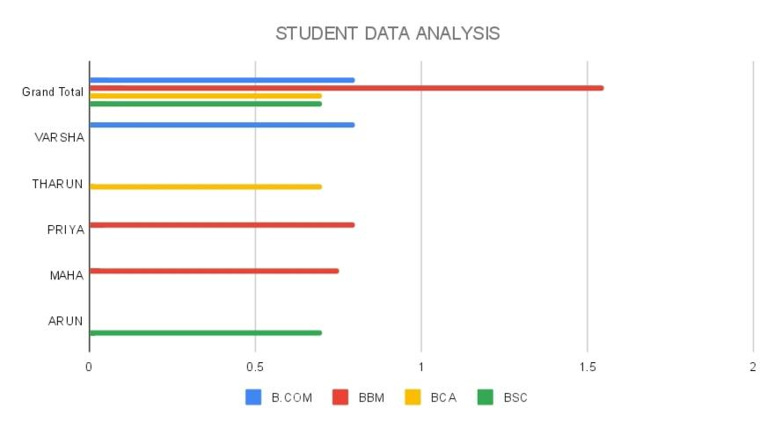
RESULTS
‹#›

Slide 12
conclusion
So, We conclude Student Performance Analysis.

